Slide 1

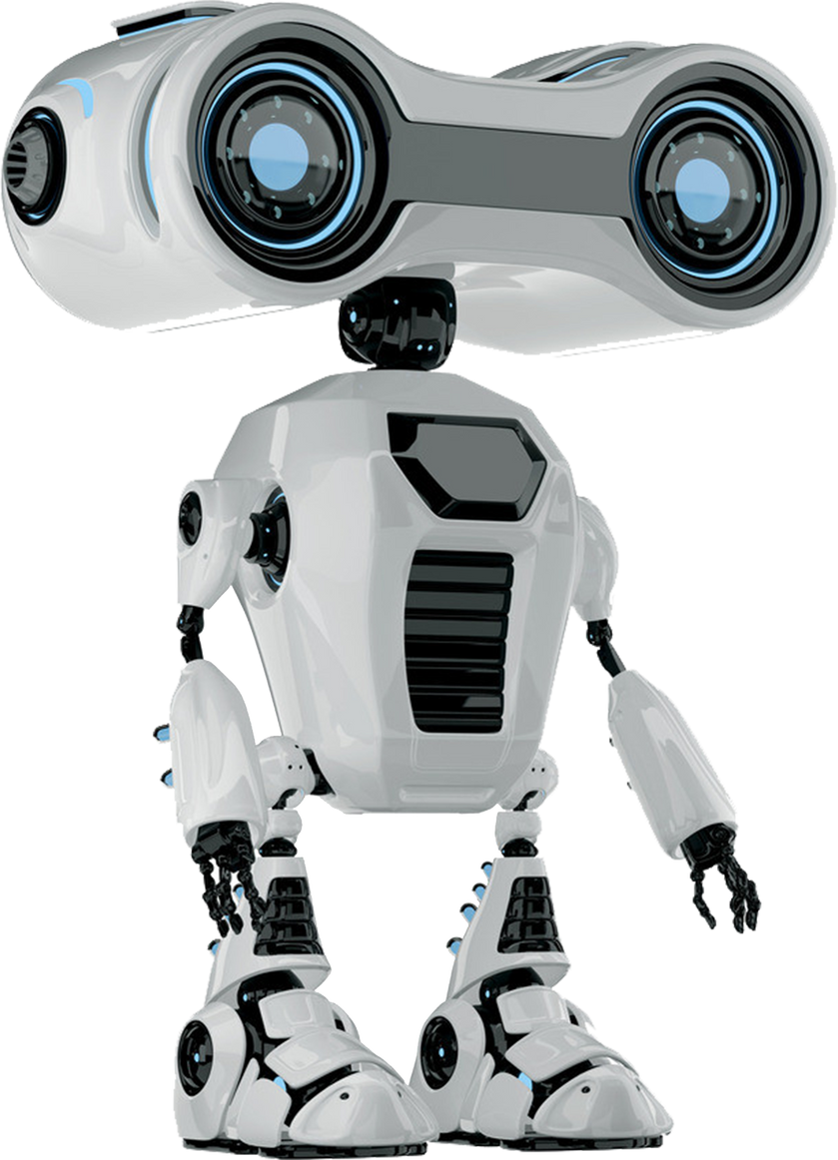



ROBOTIC CAR USING DISTANCE SENSOR IN TINKERCAD

Slide 2

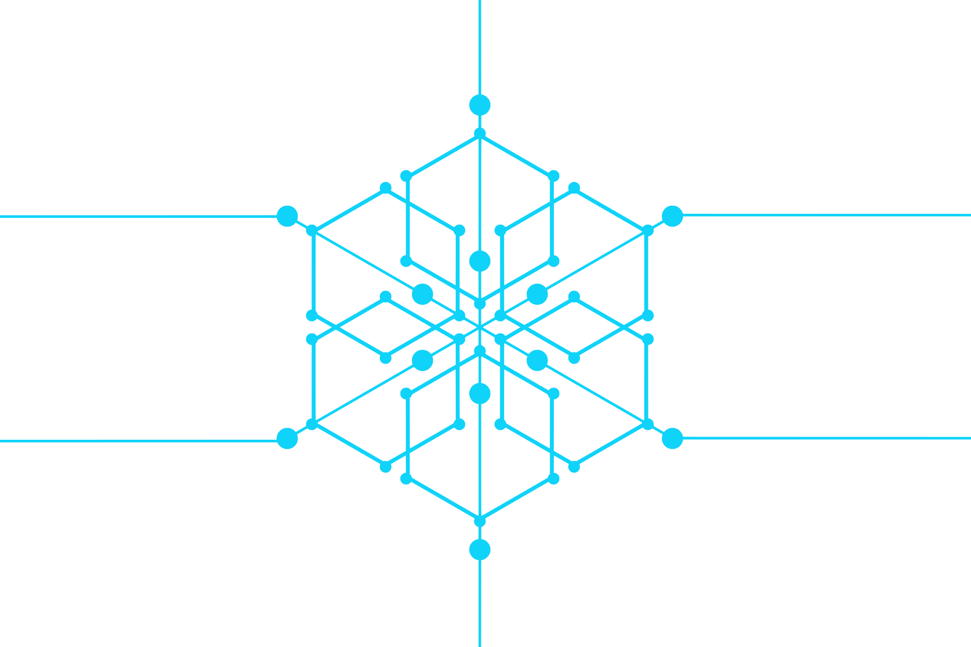

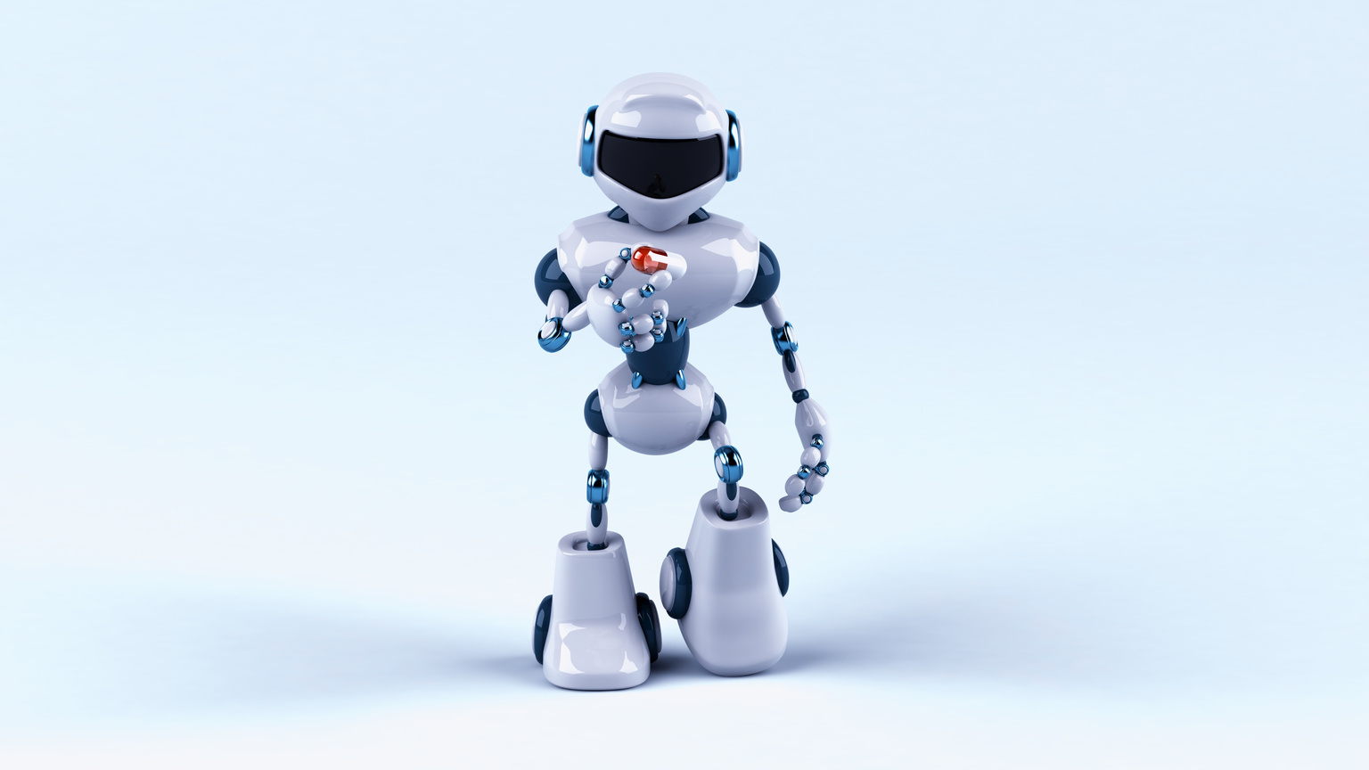

AIM:
TO DESIGN AND SIMULATE A ROBOTIC CAR EQUIPPED WITH DISTANCE SENSORS THAT CAN AUTONOMOUSLY NAVIGATE ITS ENVIRONMENT, AVOIDING OBSTACLES USING TINKERCAD.
www.reallygreatsite.com

Slide 3
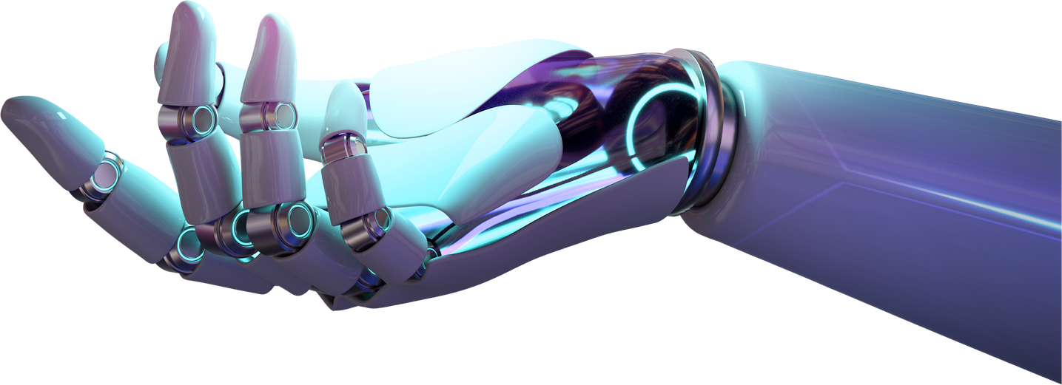


SCOPE OF THE PROJECT:
DESIGN AND SIMULATE A ROBOTIC CAR MODEL IN TINKERCAD.
INTEGRATE DISTANCE SENSORS TO DETECT AND AVOID OBSTACLES.
IMPLEMENT BASIC AUTONOMOUS NAVIGATION ALGORITHMS.
USE THE SIMULATION TO TEST AND VALIDATE THE CAR’S OBSTACLE AVOIDANCE BEHAVIOR.
THIS PROJECT CAN BE EXTENDED TO INCLUDE MORE COMPLEX NAVIGATION ALGORITHMS OR INTEGRATION WITH ADDITIONAL SENSORS.

Slide 4

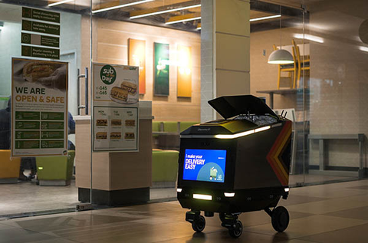

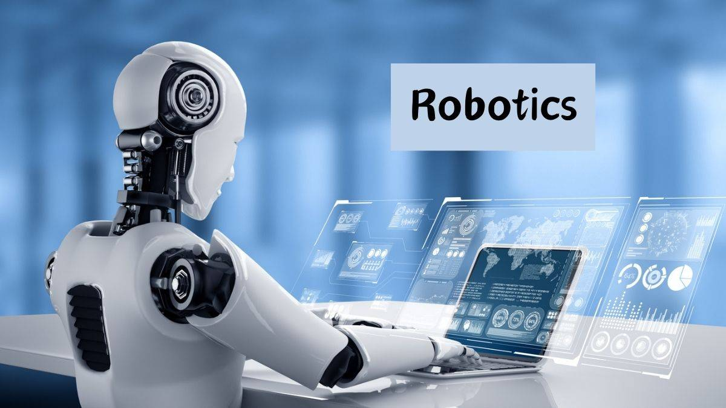
RELEVANT USE CASE OF THE PROJECT:
AUTONOMOUS NAVIGATION IN INDOOR ENVIRONMENTS, SUCH AS WAREHOUSES OR HOMES.
EDUCATIONAL TOOL FOR TEACHING ROBOTICS AND SENSOR INTEGRATION.
FOUNDATION FOR DEVELOPING MORE ADVANCED ROBOTIC SYSTEMS.

Slide 5
SOFTWARE USED :
TINKERCAD: FOR DESIGNING AND SIMULATING THE ROBOTIC CAR AND ITS COMPONENTS.
ARDUINO IDE: FOR WRITING AND UPLOADING THE CODE TO THE SIMULATED MICROCONTROLLER.
www.reallygreatsite.com

Slide 6



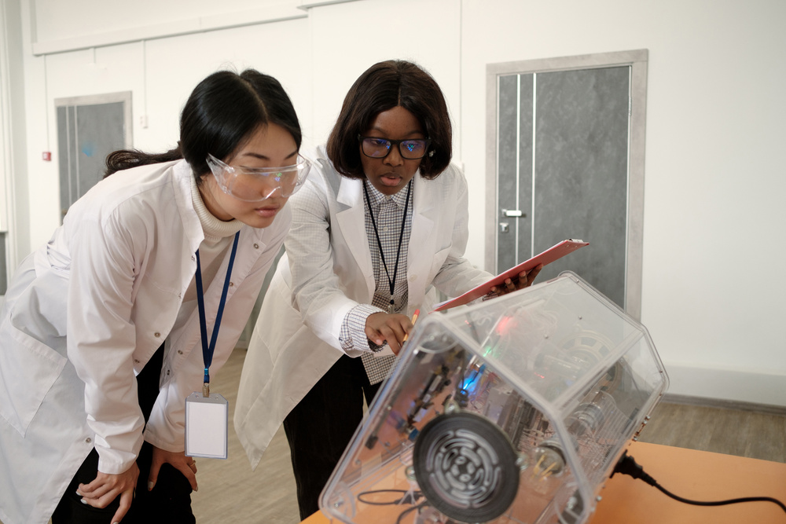


METHODOLOGIES
COMPONENT DESIGN: USE TINKERCAD TO DESIGN THE ROBOTIC CAR, INCLUDING WHEELS, MOTORS, AND SENSOR MOUNTS.
SENSOR INTEGRATION: ATTACH DISTANCE SENSORS (E.G., ULTRASONIC SENSORS) TO THE CAR AND CONNECT THEM TO A SIMULATED ARDUINO BOARD.
PROGRAMMING: DEVELOP ARDUINO CODE TO CONTROL THE ROBOTIC CAR'S MOTORS BASED ON ULTRASONIC SENSOR INPUTS, ENABLING REAL-TIME OBSTACLE DETECTION AND AVOIDANCE.
SIMULATION AND TESTING: SIMULATE THE ROBOTIC CAR'S NAVIGATION IN TINKERCAD, VALIDATING ITS OBSTACLE AVOIDANCE BEHAVIOR THROUGH ITERATIVE TESTING AND ADJUSTMENTS.

Slide 7
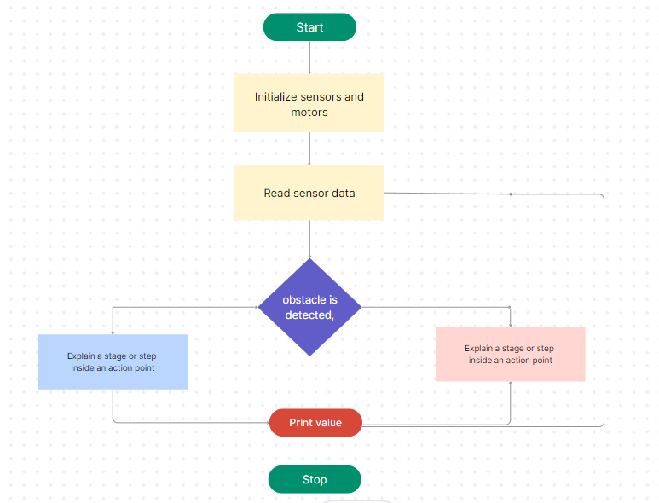
FLOW CHART & ALGORITHM

Slide 8


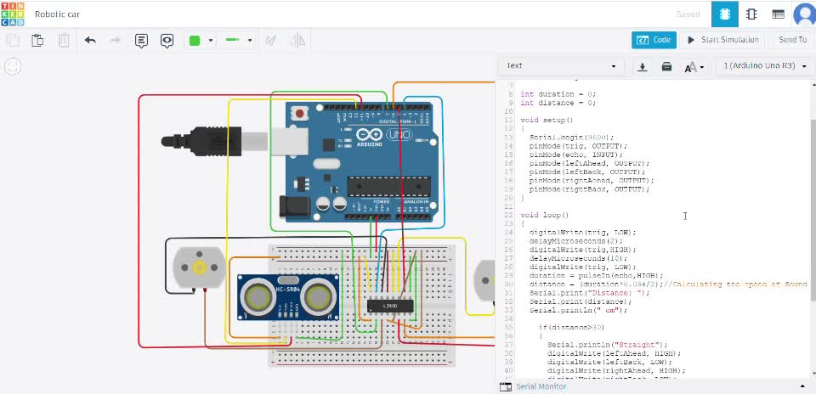

Stimulation output video

Slide 9


Result
The robotic car successfully detects and avoids obstacles using the distance sensors.
The simulation demonstrates basic autonomous navigation capabilities.

Slide 10
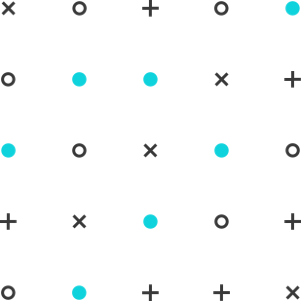
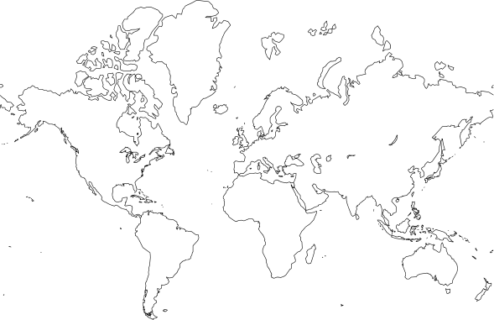

Future Scope
Integrate additional sensors (e.g., infrared, camera) for more advanced navigation.
Implement more sophisticated algorithms for path planning and object recognition.
Transition from simulation to a physical prototype for real-world testing.
Explore machine learning techniques for improving obstacle detection and decision-making processes

Slide 11
THANK YOU!

